Slide 1

Reusing existing learning materials Licensing & Attribution
Sonja Filiposka (UKIM)
Notes:
15 mins

Slide 2
Agenda
Identify permissible licenses
Provide attribution for reused content
Define how others should cite your work

Slide 3
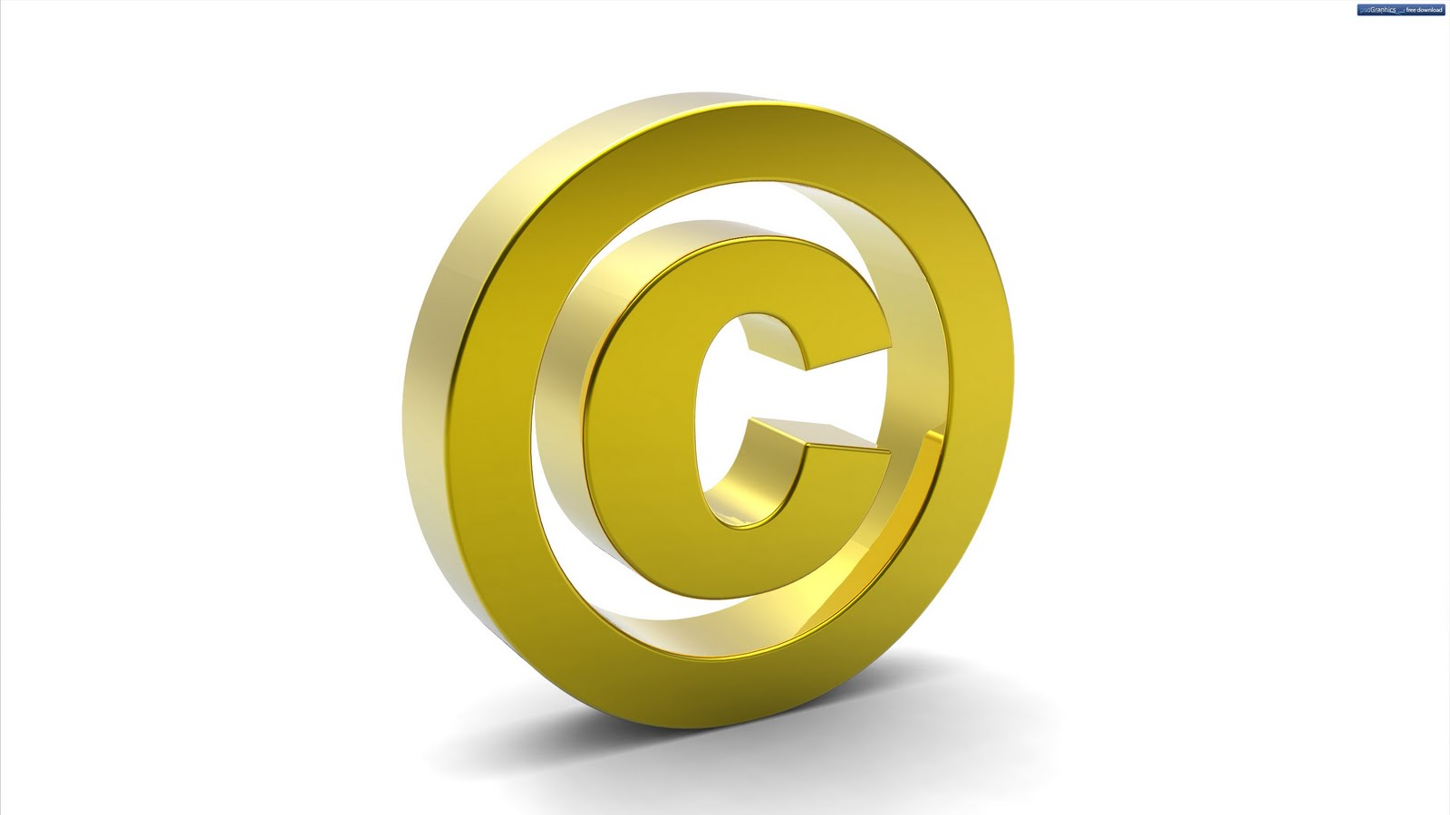
Reusing existing content
Before you reuse any existing content check the license
Content MUST be available under a permissible license
If the content is not available under a permissible license you can
Only cite it
Reach out to the owner and ask for permission for reuse
Best to stick to content available under CC (or similar) licenses
Even then you need to be careful
This Photo by Unknown Author is licensed under CC BY-SA-NC

Slide 4


Creative Commons Licenses
Taken from Creative Commons license Wikipage (2023, June 21) in Wikipedia licensed under the Creative Commons Attribution-ShareAlike License 4.0 / cropped

Slide 5
Combining and Remixing CCs
Combining = combine learning materials from different sources available under different licenses
you may combine any CC-licensed content as long as you provide attribution and
Remixing = derivative = adaptation => when the modified work manifests sufficient new creativity to be copyrightable
Adaptation creates some new version of the original form
comply with the NonCommercial restriction if it applies
comply with the NoDerivatives restriction if it applies
Try to avoid this whenever possible

Slide 6

Remixing compatible CCs
CC License Compatibility Chart from CC FAQ website licensed under the CC BY 4.0 license

Slide 7

Adapter’s license
Adapter’s license chart from CC FAQ website licensed under the CC BY 4.0 license

Slide 8
Attribution
Moral right - always needed
Everything you reuse MUST be attributed to the author
How to attribute:
If supplied, you must provide
the title of the material
the name of the creator and attribution parties,
a copyright notice,
a license notice,
a disclaimer notice, and
a link to the material
Check if the author has a preferred way for attribution
Use the TASL method
NO ?

Slide 9
How to attribute?
The ideal attribution = TASL
Title - what is the name of the work
Author - who allows you to use the work (name and link)
Source - where can the work be found (link added to title)
License - how can the work be used (name and link to the license)
CC Recommended practices for attribution
Title
Author
Source
License

Slide 10
Attribution examples
Image attribution
"Creative Commons 10th Birthday Celebration San Francisco" by Timothy Vollmer is licensed under CC BY 4.0
Adapted image attribution (if derivatives are allowed)
"Creative Commons 10th Birthday Celebration San Francisco" by Timothy Vollmer is licensed under CC BY 4.0 / Cropped from original
Text attribution
This chapter is from “You Don't Know JS Yet (2nd Edition)” by Kyle Simpson. The book is licensed under the CC BY-NC-ND 4.0 license. © 2019-2022 Kyle Simpson.
Provided by source
Image by AUTHOR(link) from Pixabay(link)

Slide 11
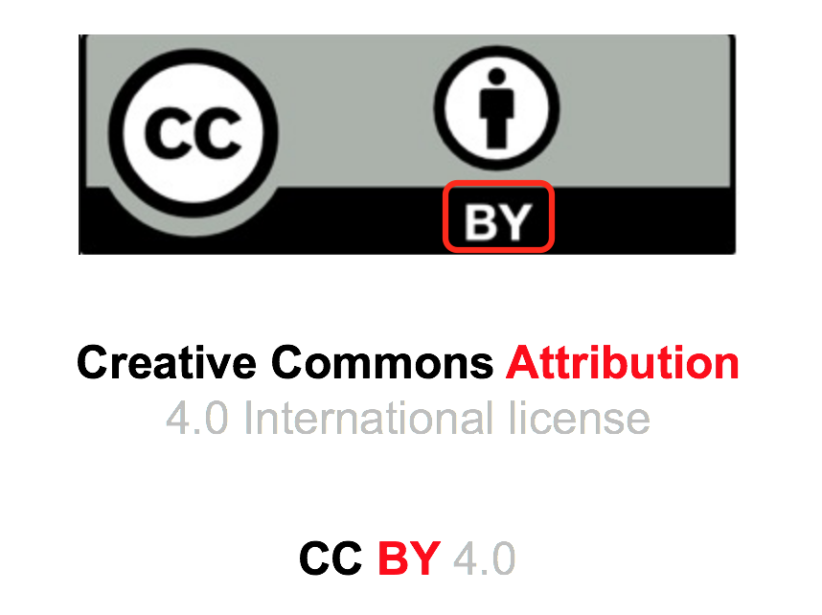
Attributing an image
Image should have permissible license
Careful when inserting online pictures from within PowerPoint
Add text under the image
For accessibility purposes:
if the image is decorative
the text box should also be decorative
Do this for ALL images
This Photo by Unknown Author is licensed under CC BY

Slide 12


Attributing music or video
Should have permissible license
Use text under the controls
“Day Bird” by Broke for Free, available under the CC BY 3.0 license, at Free Music Archive
“Twenty Years of Creative Commons (in Sixty Seconds)” by Ryan Junell and Glenn Otis Brown for Creative Commons is licensed via CC BY 4.0

Slide 13
Attributing small content in a larger collection
You want to reuse a piece from a given material
Should have permissible license
Create a section with the reused material
Provide attribution at the beginning of the section
See example on the next slide

Slide 14
Section title (no changes)
This section is based on “You Don't Know JS Yet (2nd Edition)” by Kyle Simpson. The presentation is licensed under the CC BY-NC-ND 4.0 license.

Slide 15
Section title (with changes, derivatives allowed)
This section is an adaptation of Physical Geography and Natural Disasters by R. Adam Dastrup and is used under a CC BY-NC-SA 4.0 licence. Changes include rewriting some of the bullets.
The material in this section should be made available using a corresponding adapter’s license.

Slide 16
Section title (some original material AND some material from another source)
This section contains material taken from Physical Geography and Natural Disasters by R. Adam Dastrup and is used under a CC BY-NC-SA 4.0 licence. Changes include rewriting some of the bullets and adding original material.

Slide 17
Attributing materials from multiple sources
You want to reuse one or multiple pieces from different places
Each should have permissible license
Each source should have its own attribution based on TASL
It should be clear which attribution belongs to which work
Divide into sections if applicable
Provide attribution for each section as previously
Just one piece from a given source
Provide attribution before the piece itself

Slide 18
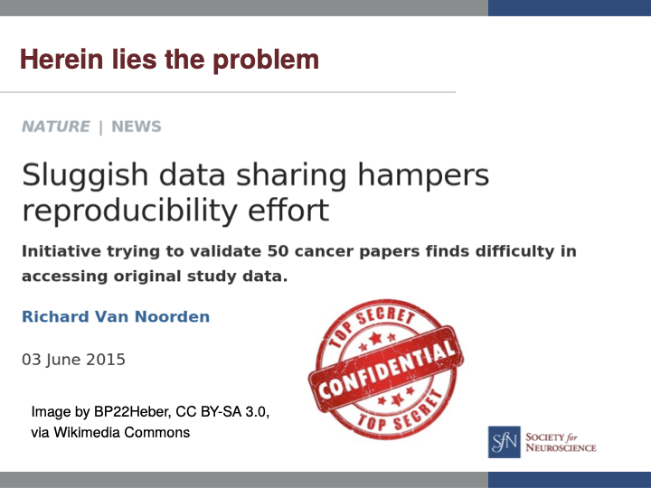
Reusing a slide example
Slide from Sharing in Science: Openness as a solution to improve reproducibility by Erin C. McKiernan available on figshare under CC BY 4.0 license
Notes:
http://whyopenresearch.org/slides

Slide 19
When authorship and copyright are different
situations when an author does not own the copyright to the work they have created
the attribution statement should include a copyright statement
An adaptation of Clinical Procedures for Safer Patient Care by Glynda Rees Doyle and Jodie Anita McCutcheon, © 2015 British Columbia Institute of Technology, and is used under a CC BY 4.0 licence.

Slide 20
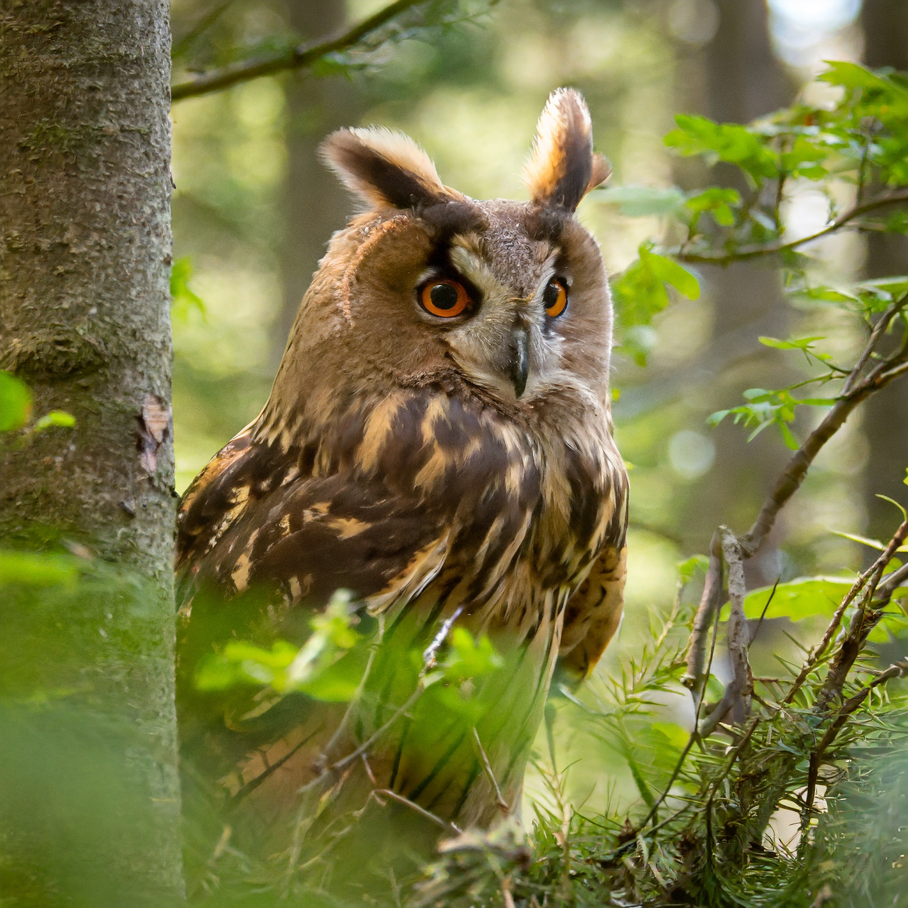
Attributing AI generated image
provide the name of used AI engine
provide the prompt used to generate
Note:
Current copyright law only recognises humans as creators
Currently no clear guidelines for how to attribute AI-generated images exist
Referencing AI images guidelines
Image generated using Adobe Firefly from the prompt brown owl in a forest.

Slide 21
Attributing AI generated text
Open Science refers to a movement that promotes transparency, accessibility, and collaboration in scientific research. It encompasses various practices aimed at making the research process and its outputs more accessible, reproducible, and inclusive.
Provide the following information:
how you used the AI tool,
the prompt used,
the date you used the tool, and
the name, creator and version of the AI tool.
Note:
it is important to explain that an AI tool was used in the creation of the work
Referencing AI-generated text
Text generated using ChatGPT, April 11, 2024, OpenAI, prompt: What is Open Science?
Deep learning and machine learning are both subfields of artificial intelligence (AI), but they differ in terms of their approach, complexity, and the types of problems they can solve.
Text generated using ChatGPT, June 26, 2023, OpenAI

Slide 22
Citing
Allows authors to provide the source of any quotations, ideas, and information that they include in their own work based on the copyrighted works of other authors
The amount of information quoted must be very limited
“Fair Use” of copyright law
Sole purpose: illustration for teaching or scientific research with attribution
Careful: varies across countries

Slide 23
Define how-to cite for your own material
Use Citation File Format (CFF)
CITATION.cff
Template provided in the FAIR-by-Design Methodology Template repository
https://citation-file-format.github.io/
Can be used to
generate a CFF
validate a CFF
Compatible with the ZENODO citation format

Slide 24
Thank you! Any questions?
sonja.filiposka@finki.ukim.mk

